Slide 1
Performance Analysis of Multi-Region Web Application Distribution Strategies
CMPT 815
Atridad Lahiji

Slide 2
Motivation
The web is too centralized!
Many commonly accessed websites are hosted in North America (typically the US)
These services are accessed worldwide, which results in a worse experience for users in a different region.
  Example: https://atri.dad is hosted in Germany. The homepage takes ~811ms to load via a symmetric gigabit FTTH connection.
CDNs help for static content, but cannot do the same for dynamic content

Slide 3
How do we solve this?
What if the server was right beside the user?
Distributed architectures help alleviate this issue
  Replicate your server across multiple regions
  Clients will connect to the closes region, potentially reducing latency
  Inherent fault tolerance at the server level
Drawbacks:
  Routing becomes more challenging
  Maintaining state between multiple regions is not trivial
  Higher cost to operate (server cost + engineering overhead)

Slide 4
Proposed architecture
A “standard” web application
Three layers:
  App Server
  Database
  In-memory Cache

Slide 5
Proposed implementation
Distribute all the things!
Server Hosting: fly.io
  Anycast DNS
  Easy scaling to ~35 regions
Databse: Turso
  Distributed LibSQL (SQLite fork with open contributions)
  Same regions as fly.io (runs on their platform)
Cache: Upstash
  Distributed Redis in-memory cache
  Same regions as fly.io (runs on their platform)

Slide 6
One small problem…
$$$
Running replicas can be expensive
Finding the optimal solution:
  Incrementally distribute each layer of this stack
  Measure performance and compute cost at each step

Slide 7

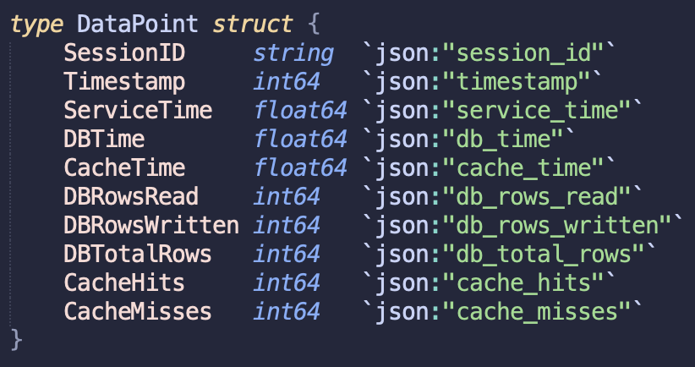
What I am measuring
Server-side:
  Service time
    DB Time
    Redis Time
    (Implicit) Combined server + microVM
Client-side:
  Total Requests Sent
  Total Responses Received
  Average/Min/Max Latency
  Target/Actual Requests Per Second
  Responses Per Second

Slide 8
What I am not measuring
Noisy neighbour interference due to shared resources
Overhead from Anycast DNS and routing
Other cloud providers*
Specific Golang http library overhead

Slide 9
Gathering Data
Run Loadr with patter: 2p3g
Control - Single Region Server - ord (Chicago)
  Test connections from clients in 3 regions:
    ord (Chicago)
    fra (Frankfurt)
    sin (Singapore)
Same clients - Scale the server to all regions
Same clients - Scale the server and cache to all regions
Same clients - Scale the server, database, and cache to all regions

Slide 10
Tools Used
Two Projects:
  Server: cmpt815perf - https://git.atri.dad/atridad/cmpt815perf
    Web server written in golang and deployed via Docker to fly.io
    When /api/request is hit, write or read from a test_data table and log metrics in a metric table
      Metrics logging is asynchronous
  Load Tester: loadr - https://git.atri.dad/atridad/loadr
    CLI Written in golang
    Configurable with requests/second and maximum number of requests
    Allows for verb patterns (ex. 1p4g is 1 POST, 4 GET, … repeated)

Slide 11
Cache Strategy
Write-around cache
  Similar to write-through
    Writes only go to the DB
    The first read following a write will miss the cache
    The cache is then updated
  Good performance overall
  Allows wide range of cache invalidation, miss, and hit events

Slide 12
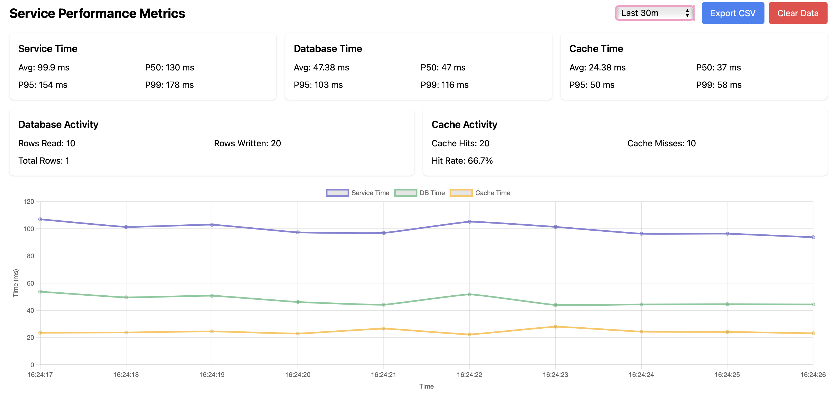
Measurements: Metrics Dashboard

Slide 13
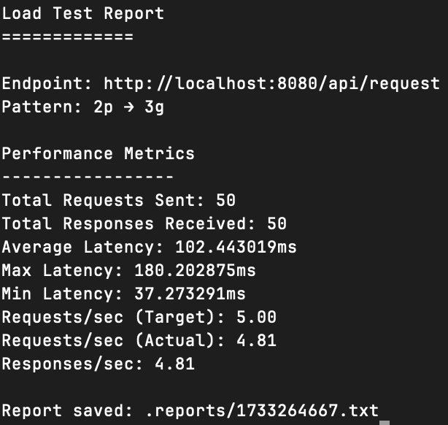
Measurements: Loadr
Logs useful information
  Endpoint
  Verb Pattern
  Requests/responses sent
  Min/Max/Avg Latency
  Requests/Responses per second
Dumps the metrics to a .txt file

Slide 14
Costs
Prices in USD
Server Hosting:
  $0.0027/hr for 1 Shared CPU + 256MB of RAM
Database:
  1 million row reads free -> $1/million after
  25 million row writes free -> $1/million after
  9GB Storage free -> $0.75/GB after
Cache:
  1000 commands per second hard limit
  100K commands for $0.20, pay as you go
Total for my tests: $1.61 USD

Slide 15
Predictions
Single region for all resources best overall
  Data consistency can be problematic
  Cost is not trivial
  Implementation complexity for real-time systems
The Database scaling will be the bottleneck:
  Quote from Turso’s docs: “Database operations are tightly controlled to maintain order and data integrity, with primary instances handling all writes in a serialized manner and replicas managing local reads.”
  Even though a client in Frankfurt will hit the Frankfurt server, that server will still write to the primary in Chicago.

Slide 16


Questions?
Server Source Code
Client Source Code

